Slide 1


Deploy a Bitnami ownCloud Stack on Linode
Presented by QPG, Ltd. Co.

Slide 2

QPG, Ltd. Co.
I spent over a decade in telecom with Integra, Electric Lightwave, and Worldcom. I currently own QPG, Ltd. Co., a technical consulting firm with a focus on Linux, networking, and virtualization.
Link Porterfield

Slide 3
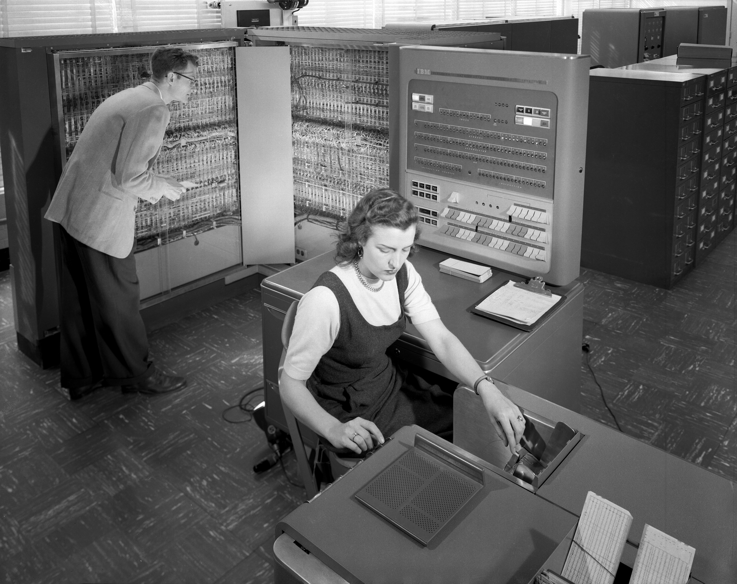
Overview
What is Bitnami?
What is ownCloud?
What is Linode?
How do I get my Bitnami ownCloud on Linode?

Slide 4
What is Bitnami?
Bitnami makes it easy to run your favorite server apps anywhere
Bitnami is a library of popular server applications and development environments that can be installed with one click, either in your laptop, in a virtual machine or hosted in the cloud. We take care of compiling and configuring the applications and all of their dependencies (third-party libraries, language runtimes, databases) so they work out-of-the-box. The resulting packaged software (a 'stack') is then made available as native installers, virtual machines and cloud images. These Bitnami application packages provide a consistent, secure and optimized end-user experience when deploying any app, on any platform.
Source: https://bitnami.com/learn_more

Slide 5
ownCloud Community Edition -- Overview
John Smith
Notes:
Welcome!

Slide 6
About ownCloud
File sync and share
Open Source
Easy to use
Easy to install
Easy to extend
>2 million users!
Notes:
OwnCloud is a file sync and share technology. You run ownCloud on your own server or pick one of the 30+ ownCloud providers.
Both server and clients are open source and are developed with the goals of being easy to install, use and extend.
ownCloud has over 2 million users, making it by far the most popular open source file sync and share technology.

Slide 7
ownCloud Open Source Momentum
Total of 57,000 commits by 550 contributors, 1,500 commits per month
More than just File Sync and Share
  Powerful application and integration platform
  7-10 apps are updated or released per week
  top 10 apps have between 11,000-26,000 downloads
Notes:
Aside from having many users, ownCloud also has a large development community.
In part that is because ownCloud is more than sync and share. Our apps bring functionality like calendar and contacts, mail, notes and much more to ownCloud.

Slide 8
ownCloud -- For end users
Notes:
Let's talk about what ownCloud has to offer for end users.

Slide 9
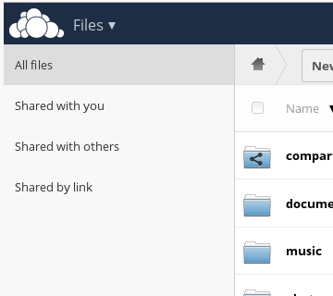
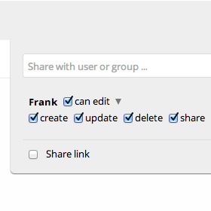
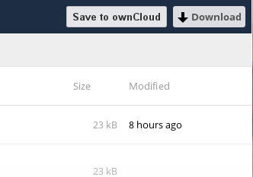
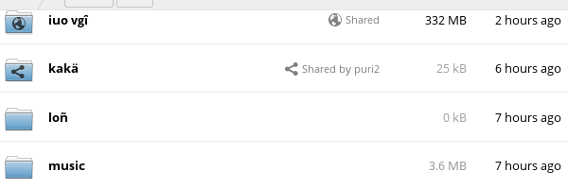
Sharing
Notes:
Sharing is an important aspect of ownCloud. ownCloud shows you who shared what with whom and how and lets you set precise permissions, expiration dates and passwords on shares, both for sharing links and for shares with other users on your ownCloud.

Slide 10
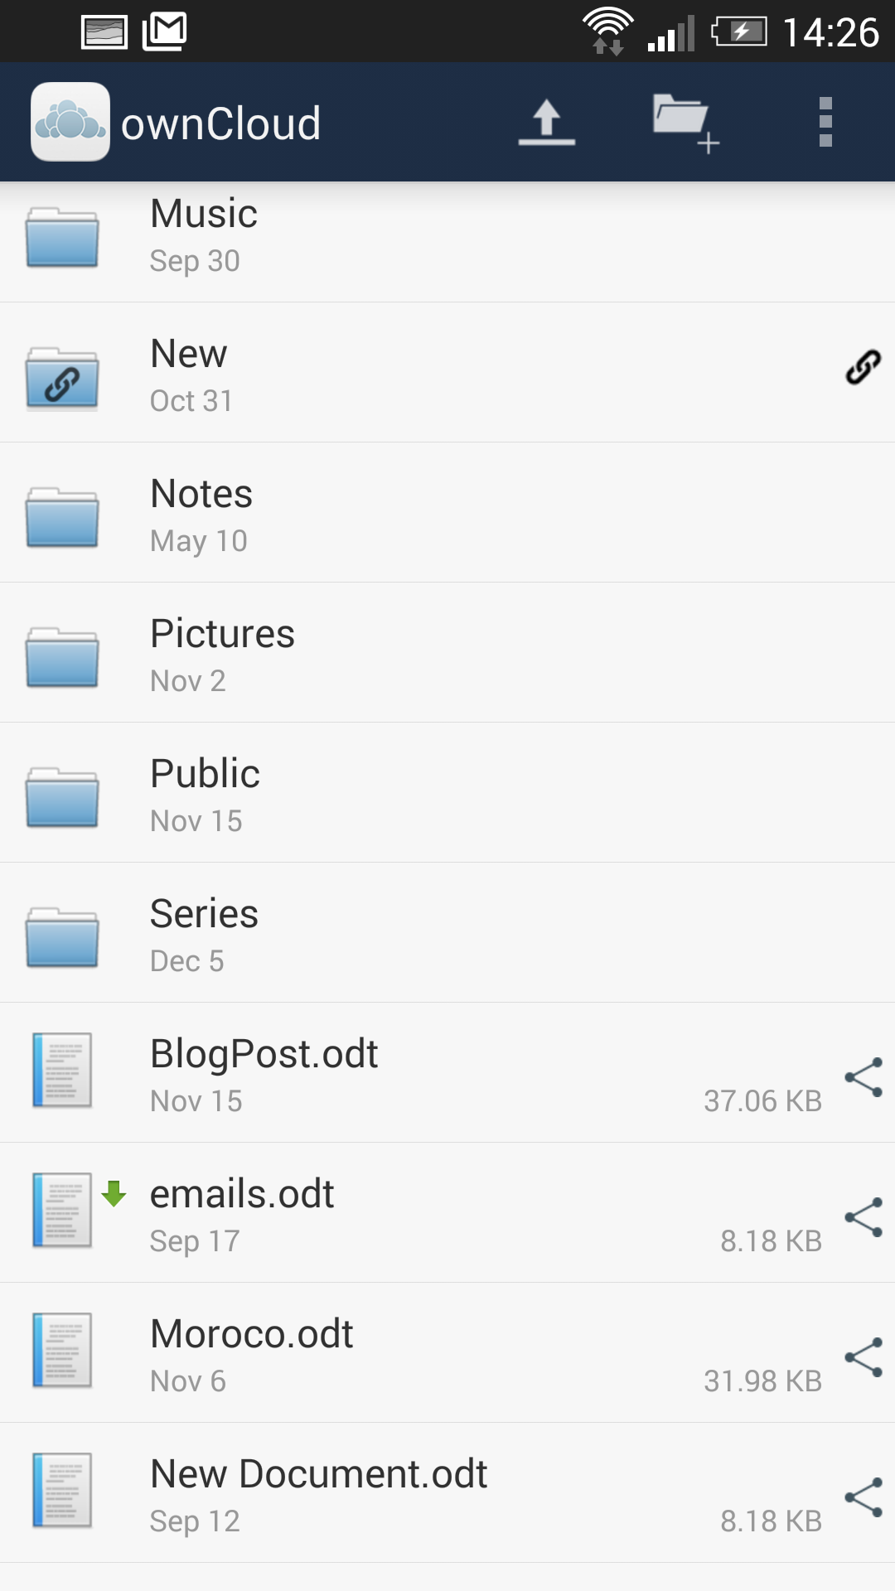
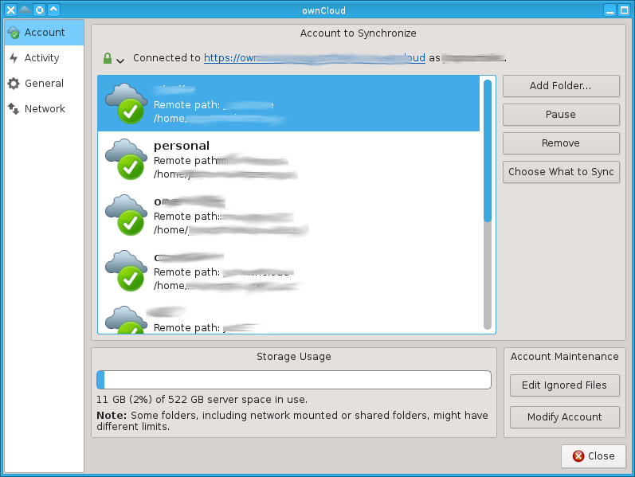
Syncing apps
Notes:
ownCloud offers sync apps for Windows, Mac and Linux as well as Android and iOS. Third party apps exist for Windows Mobile and Sailfish and there are loads of external apps with ownCloud integration thanks to our open source android and iOS integration libraries.

Slide 11
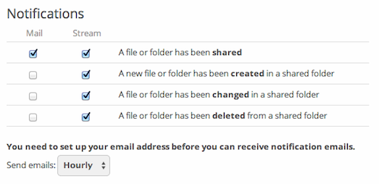
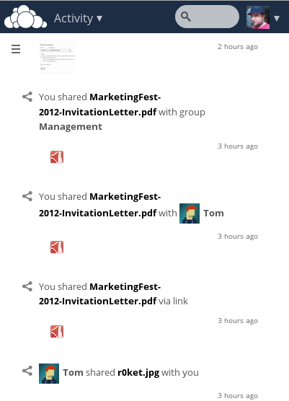
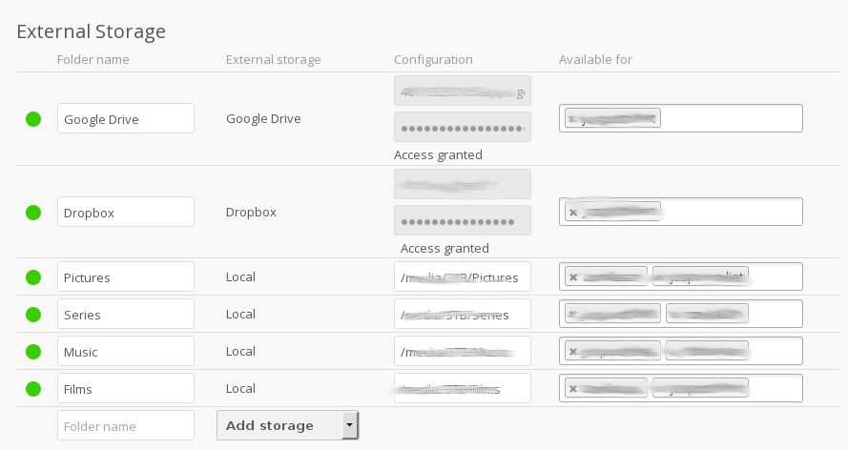
Features
Notes:
Let me mention some other ownCloud features.
ownCloud seamless integrates external storage and with the Encryption app you can encrypt the data on external storage!
The Activity app shows what happened in your ownCloud and sends you notifications.

Slide 12
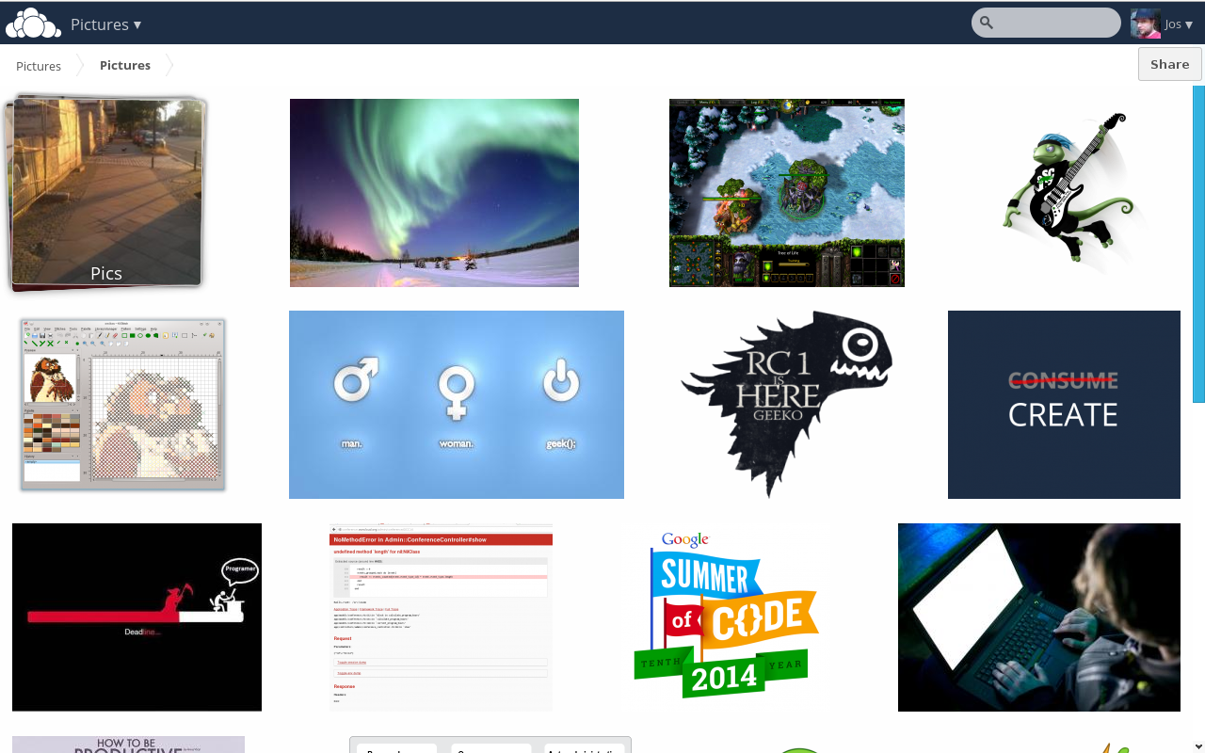
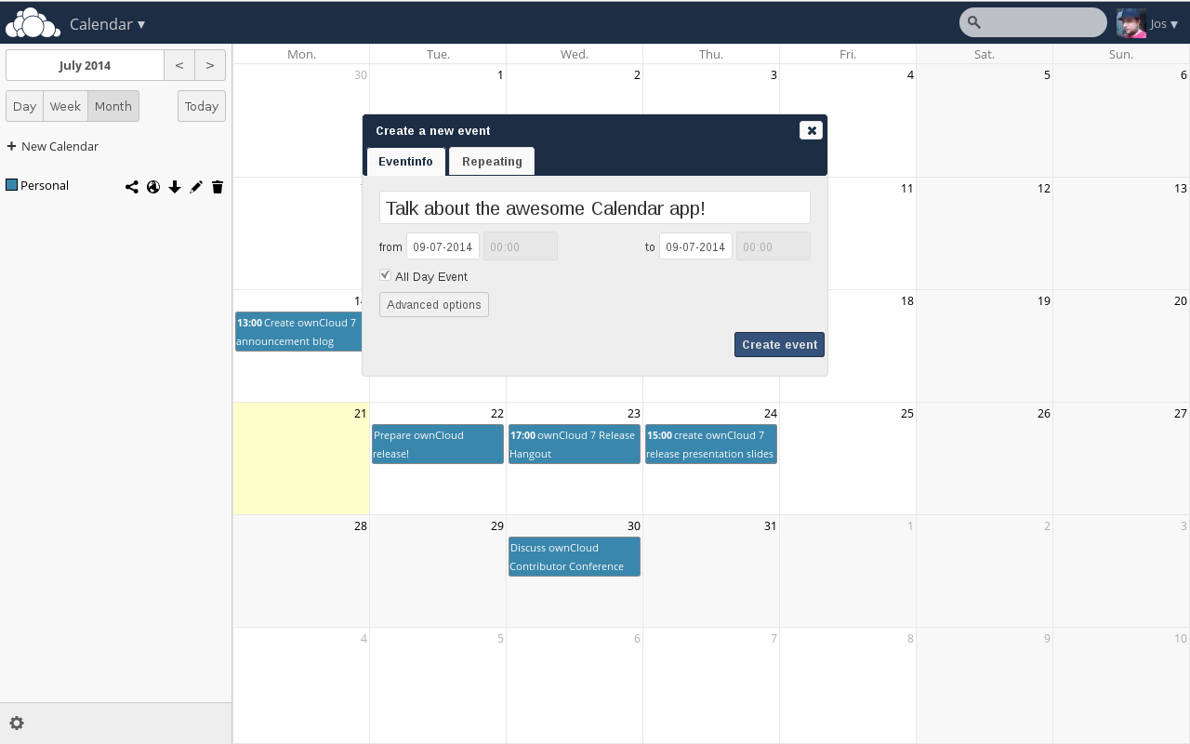
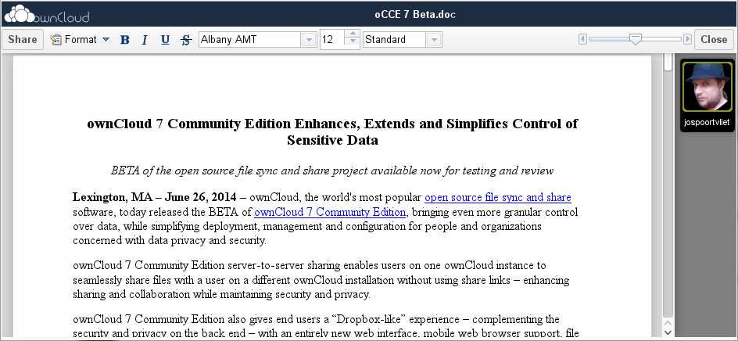
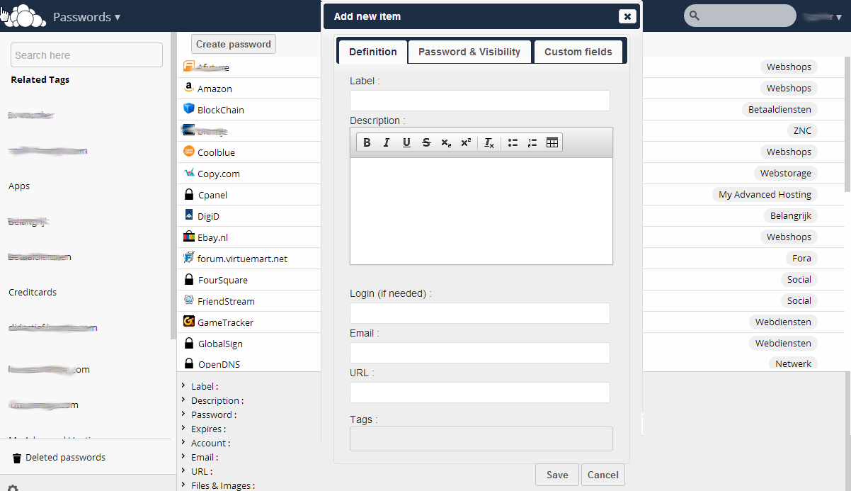
More apps
Notes:
Last but not least, there are the ownCloud apps, like Gallery, Documents (with collaborative editing!), calendar and contacts and many others like a password manager, mail, bookmarks and so on.

Slide 13
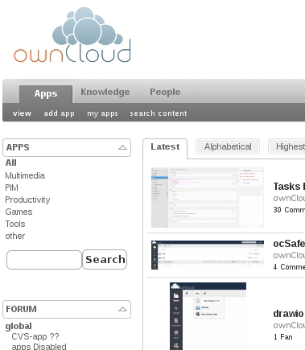
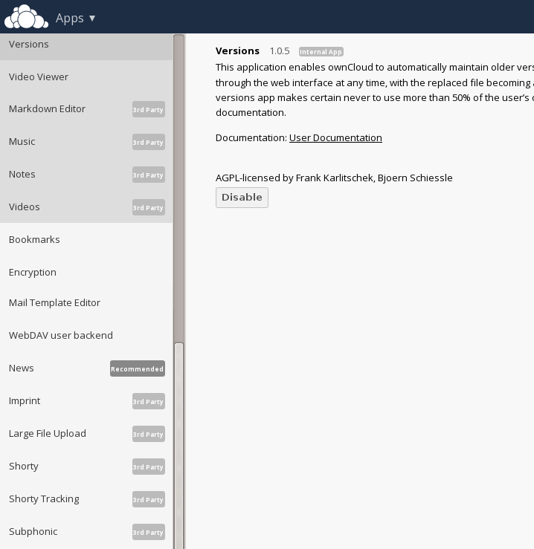
App management
Notes:
Apps can be installed from the ownCloud App manager or from the ownCloud app store, which features over 200 ownCloud apps!

Slide 14
ownCloud--For administrators
Notes:
ownCloud is easy to maintain, but gives a lot of control to system administrators.

Slide 15
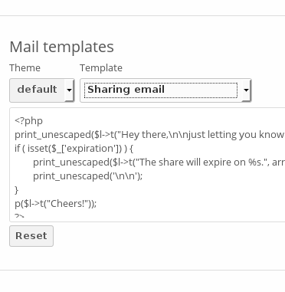
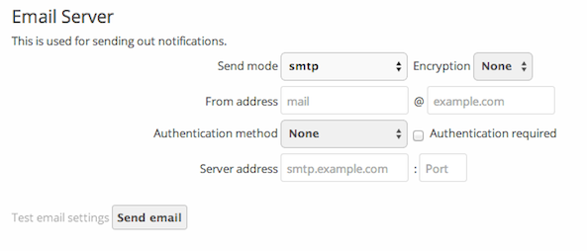

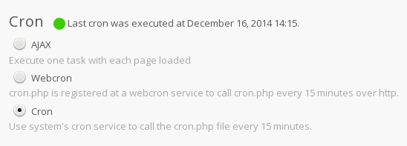

Management
Notes:
ownCloud makes it easy to manage your installation. It warns you about security issues and other problems, lets you fine-tune what your users can and can't do and all that in an easy user interface.

Slide 16
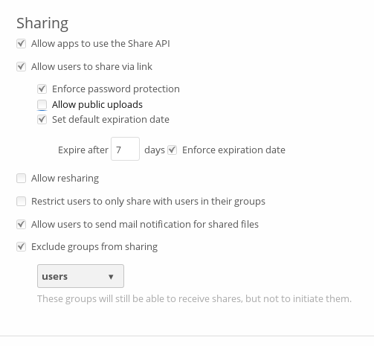
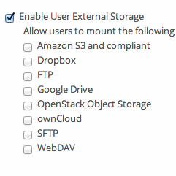
Control Sharing
Notes:
You can control sharing and the use of external storage to protect your users' data

Slide 17
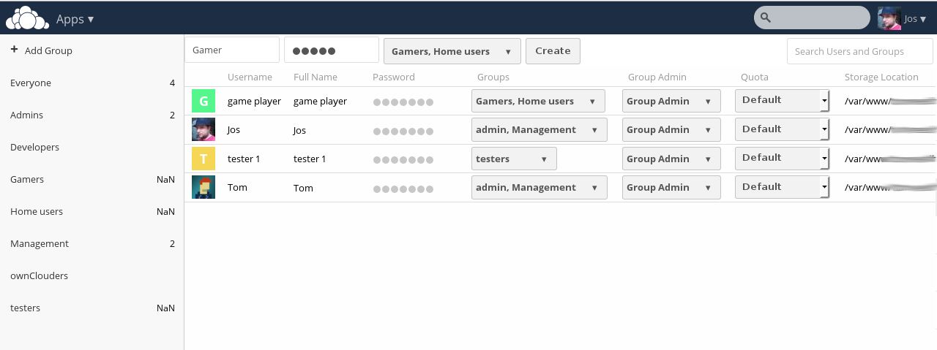
User management
Notes:
And of course manage the users themselves, with groups and permissions.

Slide 18
ownCloud -- For developers
Notes:
ownCloud is always looking for developers. We offer easy API's to develop apps with and of course welcome contributions to the existing apps and core of ownCloud.

Slide 19
App developers
API inspired on Rails and Symfony
Generator for base app with dependency injection, routing, database layer, middleware and controllers
doc.owncloud.org & #owncloud-dev
Third party developers
Pub/sub model Webhooks
API for sharing, list, up/download etc

Slide 20
Links
Get it on owncloud.org/download
Try it on demo.owncloud.org
Join on owncloud.org/contribute
Find help on doc.owncloud.org
For large scale use see ownCloud.com

Slide 21
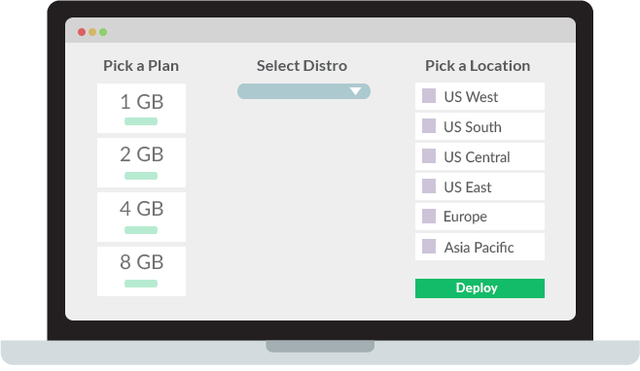
What is Linode?
Linode offers multiple products and services for its clients. Its flagship products are cloud-hosting services with multiple packages at different price points. Linode Backup allows customers to backup their servers on a daily, weekly, or monthly basis. Linode Manager and NodeBalancer both allow users to manage multiple server instances across a single system.
Source: https://en.wikipedia.org/wiki/Linode

Slide 22

Deployment

Slide 23

Obtain Bitnami ownCloud
Go to Bitnami website
Create account (optional)
Download ownCloud Bintami stack

Slide 24
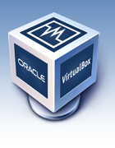
Prepare Bitnami Stack
Launch VirtualBox
Create new guest
  Linux/Ubuntu 64
  1GB RAM
  Use existing disk image
Unzip bitnami-owncloud-7.0.4-0-ubuntu-14.04.zip into ~/VirtualBox VMs/linode
Select ~/VirtualBox VMs/linode/bitnami-owncloud-7.0.4-0-ubuntu-14.04/bitnami-owncloud-7.0.4-0-ubuntu-14.04.vmdk
Edit guest settings/network/adapter 1 to bridged
Start VirtualBox guest

Slide 25
Initial login
Login (bitnami/bitnami)
Change password (can be done later, but must be done before uploading to cloud)
Enable ssh
  sudo mv /etc/init/ssh.conf.back /etc/init/ssh.conf
  sudo start ssh
Connect to guest over ssh
Setup ssh public key (optional)
  mkdir ~bitnami/.ssh
  touch ~bitnami/.ssh/authorized_keys
  chmod 700 ~bitnami/.ssh/authorized_keys
Setup SSL certificate (optional)

Slide 26
OwnCloud login
Log in to your ownCloud VM at https://$IP
  Force ownCloud to SSL (Admin/Security/Enforce HTTPS)
  Create a new user in the admin group (Users section)
    (email for username recommended)
  Log out of intial account and log in with newly created user
  Delete initial user account (optional)

Slide 27
Prepare for upload
Power off VM from CLI (sudo shutdown -h now)
In VirtualBox edit guest settings: storage/CD/DVD Drive
  Select your Finnix ISO
Restart the VM

Slide 28
Ready your Linode
Create a Linode with the same volume size as your locally running Bitnami VM and reboot it into Rescue Mode
Access Finnix Recue Mode via Lish Console
Start ssh in Finnix
  (You can do this without setting a root password if you are using ssh public keys.)

Slide 29
Upload your VM
Mount the volume you created
Rsync your Bitnami filesystem over ssh
Edit your fstab and reboot the Linode

Slide 30
Upload your VM
A more detailed version of this process can be found at: https://www.linode.com/docs/tools-reference/custom-kernels-distros/running-a-custom-linux-distro-on-a-linode-vps#migrating-the-virtual-machine-to-your-linode

Slide 31
Acknowledgements
Bitnami for allowing the use of content from their web site
John Smith of the ownCloud community for the ownCloud segment
Linode for providing refreshments and promotional gifts
Stephen Spector for organizing Boise Cloud Computing Meetup

Slide 32
Links / Questions
https://bitnami.com/
https://owncloud.org/
https://www.linode.com/
https://www.virtualbox.org/
https://www.qpg.us/

